Slide 1

Citywide effects of high-occupancy vehicle restrictions: Evidence from “three-in-one” in Jakarta
by Rema Hanna, Gabriel Kreindler, and Benjamin A. Olken
Group 6
Sirius See
席睿
Science
Volume 357(6346):89-93
July 7, 2017
Published by AAAS

Slide 2
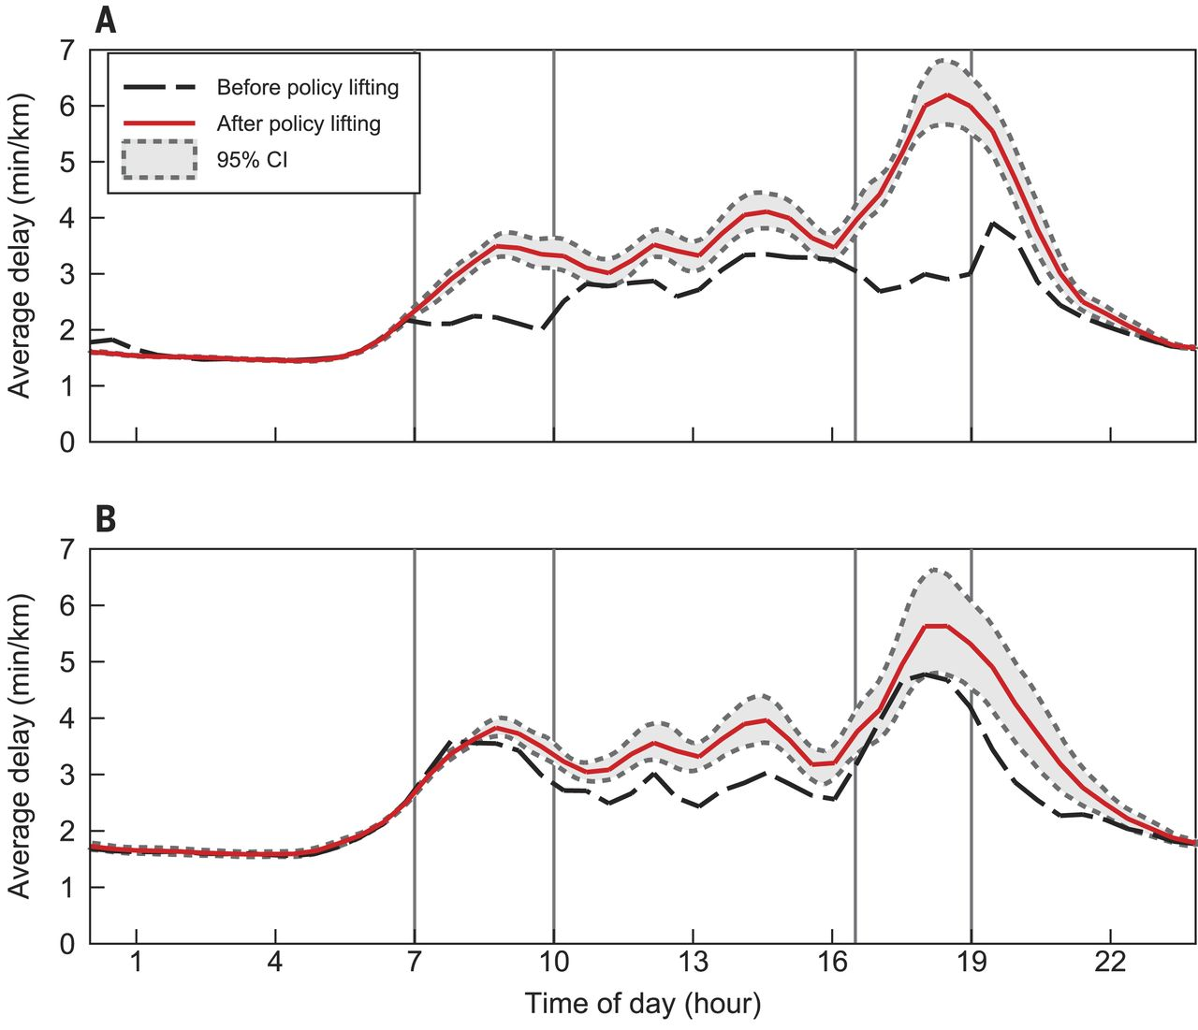
We graph the Average Delay in minutes per kilometer on the weekdays for the
Former HOV Road.
Rema Hanna et al. Science 2017;357:89-93
Published by AAAS
Notes:
Effect of three-in-one policy-lifting. (A) Former three-in-one restricted road (Jalan Sudirman) and (B) unrestricted alternate road (Jalan Rasuna Said). The graphs show locally linear regressions (Epanechnikov kernel, 0.2-hour bandwidth) of delay on departure time, before and after the lifting. Uses “live” data pre- and post-lifting. Predata are from Thursday 31 March (4:40 p.m. onward), Friday 1 April, and Monday 4 April. Postdata are from all weekdays 5 April to 4 May. For each departure time, there are two observations per route, corresponding to the two road directions. Pointwise bootstrapped 95% confidence bands around postdata, adjusted for date times road direction clusters (1000 bootstrap iterations).

Slide 3
Focus on Peak-Hour Intervals
Rema Hanna et al. Science 2017;357:89-93
Published by AAAS
Notes:
Effect of three-in-one policy-lifting. (A) Former three-in-one restricted road (Jalan Sudirman) and (B) unrestricted alternate road (Jalan Rasuna Said). The graphs show locally linear regressions (Epanechnikov kernel, 0.2-hour bandwidth) of delay on departure time, before and after the lifting. Uses “live” data pre- and post-lifting. Predata are from Thursday 31 March (4:40 p.m. onward), Friday 1 April, and Monday 4 April. Postdata are from all weekdays 5 April to 4 May. For each departure time, there are two observations per route, corresponding to the two road directions. Pointwise bootstrapped 95% confidence bands around postdata, adjusted for date times road direction clusters (1000 bootstrap iterations).

Slide 4
After Policy Lifted: Morning Peak - Increase
After Policy Lifted: Evening Peak - Increase
Rema Hanna et al. Science 2017;357:89-93
Published by AAAS
Notes:
Effect of three-in-one policy-lifting. (A) Former three-in-one restricted road (Jalan Sudirman) and (B) unrestricted alternate road (Jalan Rasuna Said). The graphs show locally linear regressions (Epanechnikov kernel, 0.2-hour bandwidth) of delay on departure time, before and after the lifting. Uses “live” data pre- and post-lifting. Predata are from Thursday 31 March (4:40 p.m. onward), Friday 1 April, and Monday 4 April. Postdata are from all weekdays 5 April to 4 May. For each departure time, there are two observations per route, corresponding to the two road directions. Pointwise bootstrapped 95% confidence bands around postdata, adjusted for date times road direction clusters (1000 bootstrap iterations).

Slide 5
After Policy Lifted: Morning Peak - Increase
After Policy Lifted: Evening Peak - Increase
Traffic decreases
in both the morning and evening peak
during the policy.
Conclusion: 3 in 1 policy helps.
Rema Hanna et al. Science 2017;357:89-93
Published by AAAS
Notes:
Effect of three-in-one policy-lifting. (A) Former three-in-one restricted road (Jalan Sudirman) and (B) unrestricted alternate road (Jalan Rasuna Said). The graphs show locally linear regressions (Epanechnikov kernel, 0.2-hour bandwidth) of delay on departure time, before and after the lifting. Uses “live” data pre- and post-lifting. Predata are from Thursday 31 March (4:40 p.m. onward), Friday 1 April, and Monday 4 April. Postdata are from all weekdays 5 April to 4 May. For each departure time, there are two observations per route, corresponding to the two road directions. Pointwise bootstrapped 95% confidence bands around postdata, adjusted for date times road direction clusters (1000 bootstrap iterations).

